Slide 1


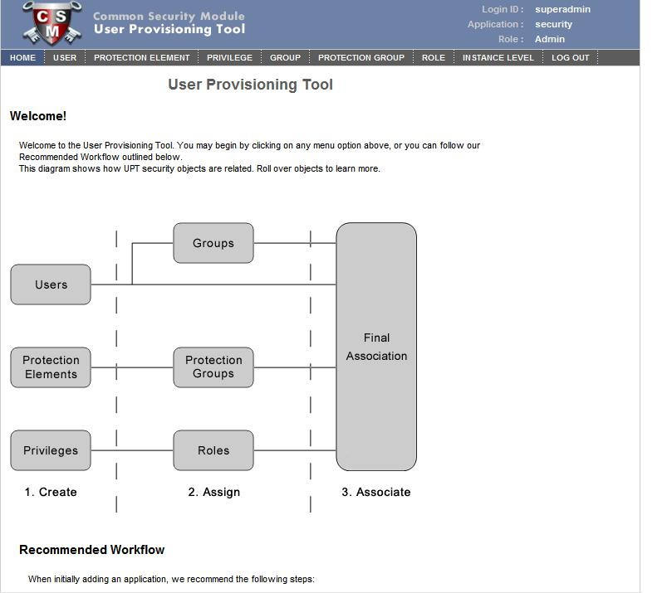

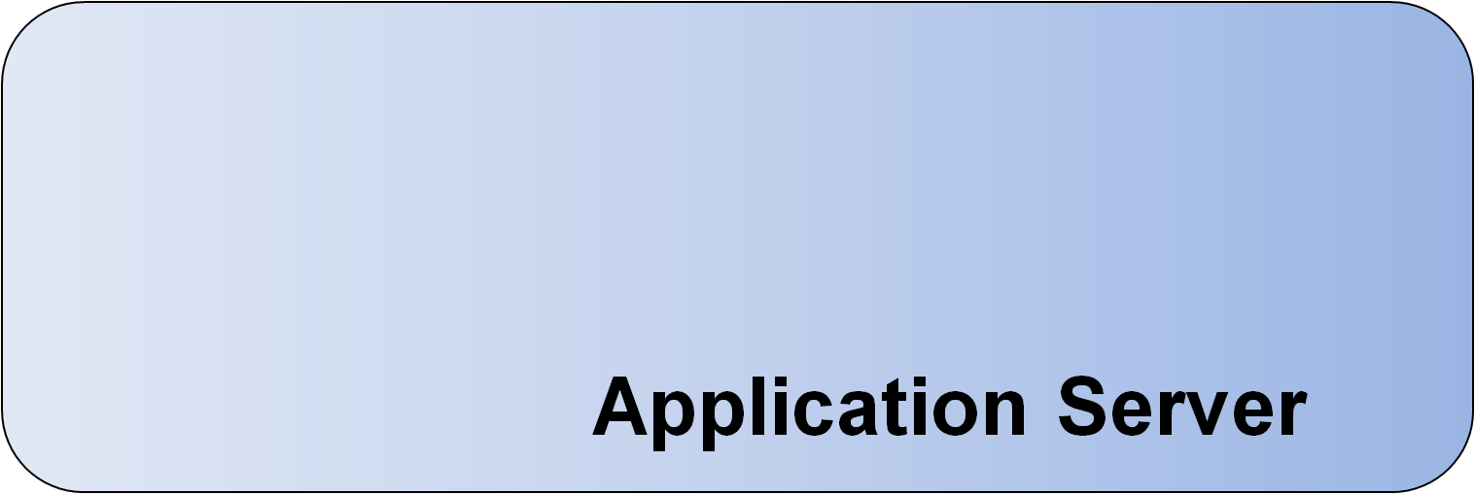
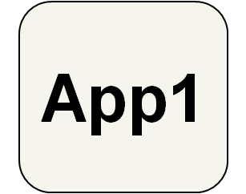
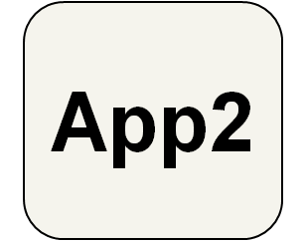


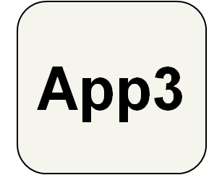
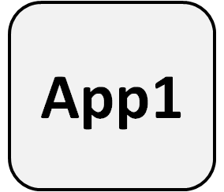
Common Security Module (CSM)
Charles Griffin, Kunal Modi, Santhosh Garmilla, Satish Patel, Vijay Parmar - Ekagra Software Technologies
Aynur Abdurazik - SAIC
Sichen Liu, Avinash Shanbhag, David Hau, Denise Warzel – NCI CBIIT
Ekagra
Overview
The CBIIT Common Security Module (CSM) provides a comprehensive, flexible solution to common security and access control objectives. CSM allows application developers to integrate security features with minimal coding effort, while benefiting from a robut and proven solution. CSM provides solutions for authentication, authorization, and user provisioning.
CSM provides solutions for:
Authentication to validate and verify a user's credentials.
Authorization to grant or deny access to data, methods, and objects. CSM incorporates an Authorization schema and database so that users can only perform the operations or have access to the data for which they have the needed rights.
The web-based CSM User Provisioning Tool (UPT) can easily be integrated with single or multiple applications and authorization databases. The UPT provides functionality to create authorization data elements like Roles, Privileges, Protection Elements and Users, and also provides functionality to associate them with each other.
CSM GAARDS Migration Module (CGMM) to migrate existing web applications from CSM authentication to GAARDS authentication.
Features
Authentication - validate user credentials against Credential Providers (LDAP, LDAPS, RDBMS)
User, Role/Group based security and Class/Object level security
Instance Level security for User or Groups
Attribute Level Security for User or Groups
CSM APIs for programmatically utilizing the Authentication and Authorization features.
CSM User Provisioning Tool: extensive Web UI to provision user authorization policy
CSM GAARDS Migration Module: CSM user account migration to GAARDS account, GAARDS authentication tool, and new caGrid account creation tool.
Audit and Logging for 21 CFR Part 11 compliance.
Upcoming Features
Backwards compatible version of CSM UPT
Performance enhancements for Instance Level Security
Build and deployment automation for CSM projects
The UPT was developed as a flexible application that can be deployed in multiple ways depending on the need or scenario. The three primary modes to install the UPT include the following:
Single Installation, Single Schema
Single Installation, Multiple Schemas
Local installation, Local schema
Overall Architecture
Installation Modes
Application server
Application XYZ
JAAS
App1 CSM Schema
App3 CSM Schema
Authenticate
Authorize
Authorize
CSM API
Authenticate
Authorize
Authorize
Common CSM Schema
Common CSM Schema
Credential Providers
Single Installation, Single Schema
Single Installation, Multiple Schema
RDBMS
LDAP
CSM Authorization Schema

